Slide 1
Principles of Data Science
Li Niu

Slide 2
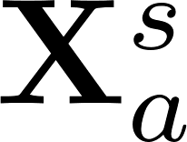
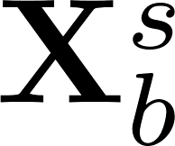
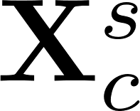
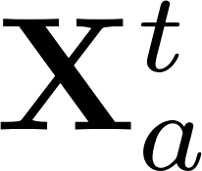
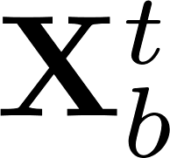
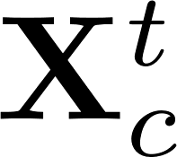
Training/testing features
Single-View Learning:
Multi-View Learning:
Training feature
Training feature
….
Testing feature
….
Testing feature
?
Learning using Privileged Information:
Training feature
….
Training feature
….
Testing feature
Testing feature

Slide 3

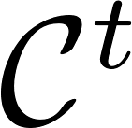
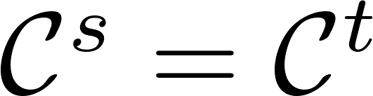
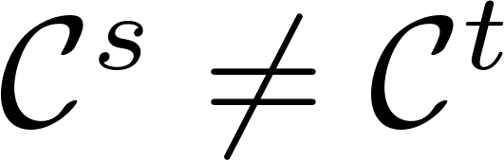


Training/testing categories
Training categories
Testing categories
Traditional setting:
New setting:
training
categories
testing
categories

Slide 4
Training/testing categories
Training categories
Testing categories

Slide 5
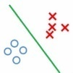
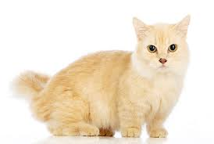


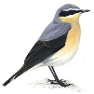
Training/testing categories
Training:
cat or not
feature extractor
dog or not
visual feature
bird or not
binary classifiers
Testing:
feature extractor
cat or not
dog or not
visual feature

Slide 6
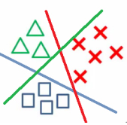
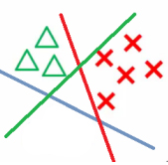
Training/testing categories
Training:
feature extractor
cat or dog or bird
visual feature
multi-class classifier
Testing:
feature extractor
cat or dog or bird
visual feature
multi-class classifier

Slide 7
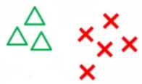
Training/testing categories
Training:
feature extractor
cat or dog
visual feature
multi-class classifier
Testing:
feature extractor
cat or dog
visual feature
multi-class classifier

Slide 8
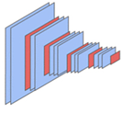
Training/testing categories
Training:
cat
dog
bird
CNN
Testing:
cat
dog
bird
CNN

Slide 9
Training/testing categories
Training categories
Testing categories

Slide 10
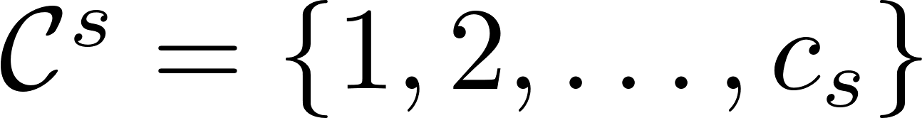
Training/testing categories
Training categories
Testing categories
Training categories and testing categories have no overlap.
In other words, we have zero training samples for testing categories.

Slide 11
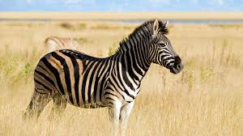
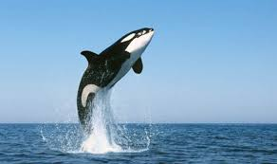
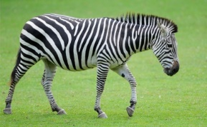
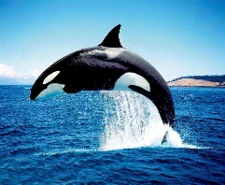
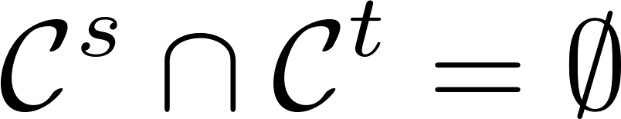
Zero-shot learning
knowledge transfer
mismatch
training
categories
testing
categories
seen categories
unseen categories
training set
test set

Slide 12
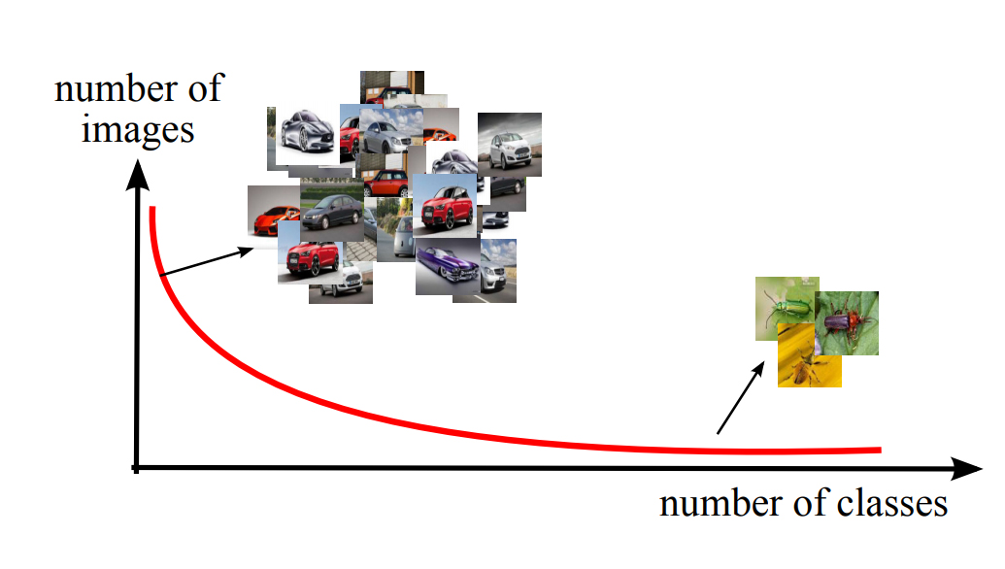
Zero-shot learning
It is impossible to collect ample annotated examples for all categories, especially for deep learning.
New categories are always emerging.
“long-tail” categories

Slide 13
Zero-shot learning
Use category-level semantic information to bridge the gap between seen categories and unseen categories.
visual space
semantic space
zebra
[1 1 0 0 ]
black-white
has tail
lives on land
small
gray
has tail
lives in water
big
whale
[0 1 1 1 ]

Slide 14
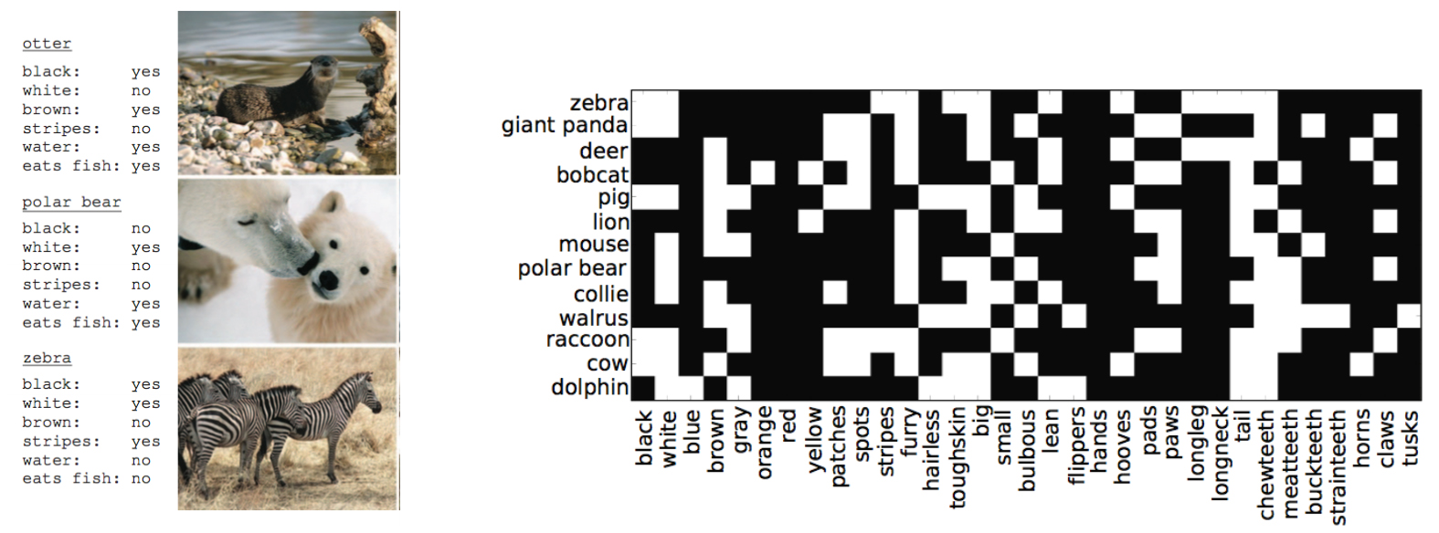
Zero-shot learning
manually annotated attribute vector
Pros: accurate if informative by design
Cons: manual annotation effort

Slide 15
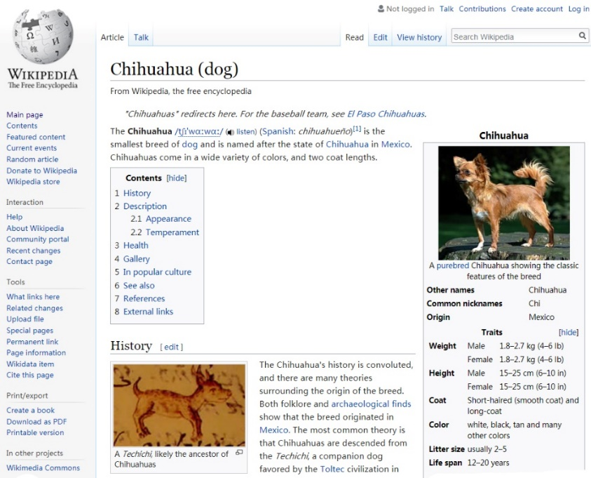
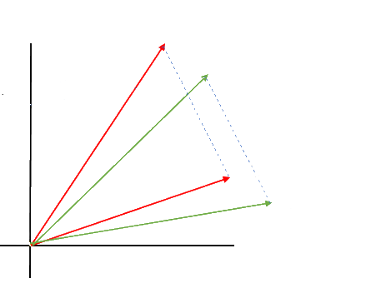

Zero-shot learning
free category-level information
textual feature of wiki page
word vector of category name
king
linguistic model
queen
man
woman
vector(king) - vector(man) + vector(woman) ≈ vector(queen)
vector(Paris) - vector(France) + vector(Germany) ≈ vector(Berlin)
Pros: automatic/Free
Cons: less informative than attributes

Slide 16

Traditional classification
category space
zebra
tiger
whale
classification
visual space

Slide 17
Zero-shot learning
category space
zebra
tiger
whale
semantic space
visual space
zebra
[1 1 0 0 ]
tiger
[0 1 0 1 ]
whale
[0 1 1 1 ]

Slide 18
Zero-shot learning methods
Semantic relatedness methods
Semantic embedding methods
Synthetic methods

Slide 19
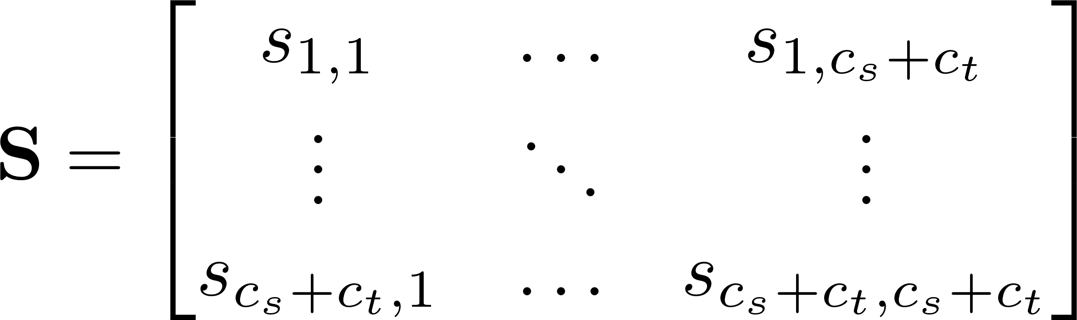

Semantic relatedness methods
category space
similarity matrix
zebra
tiger
whale
semantic space
visual space
zebra
[1 1 0 0 ]
tiger
[0 1 0 1 ]
whale
[0 1 1 1 ]

Slide 20
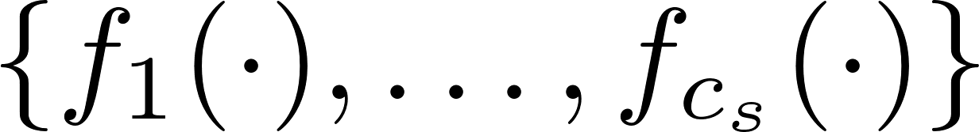
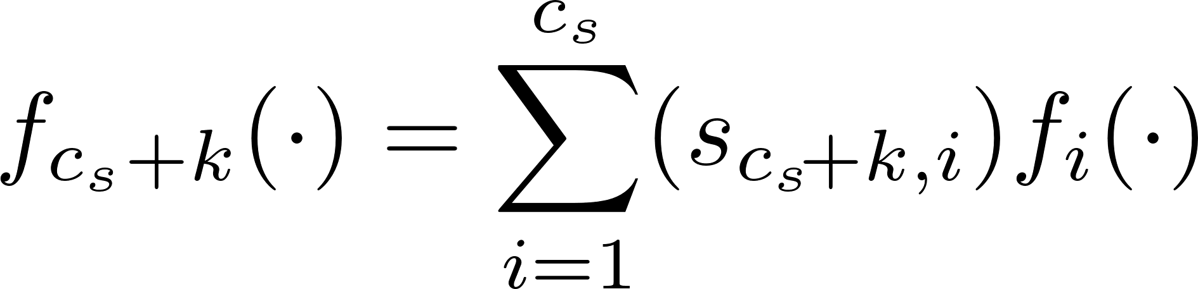
Semantic relatedness methods
category space
zebra
tiger
whale
Classifiers for seen categories:
Classifiers for unseen categories
visual space

Slide 21
Zero-shot learning methods
Semantic relatedness methods
Semantic embedding methods
Synthetic methods

Slide 22




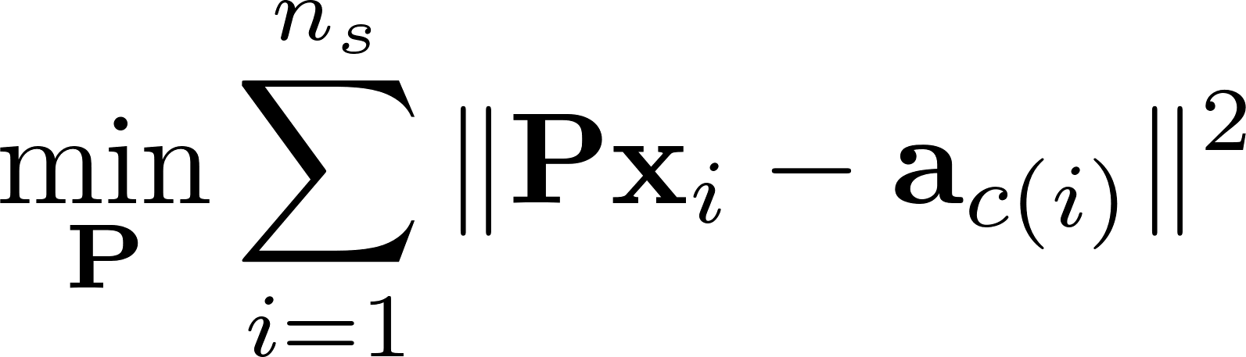
Semantic embedding methods
semantic space
visual space
zebra
[1 1 0 0 ]
tiger
[0 1 0 1 ]
whale
[0 1 1 1 ]
the category label of
Training:
Testing:

Slide 23

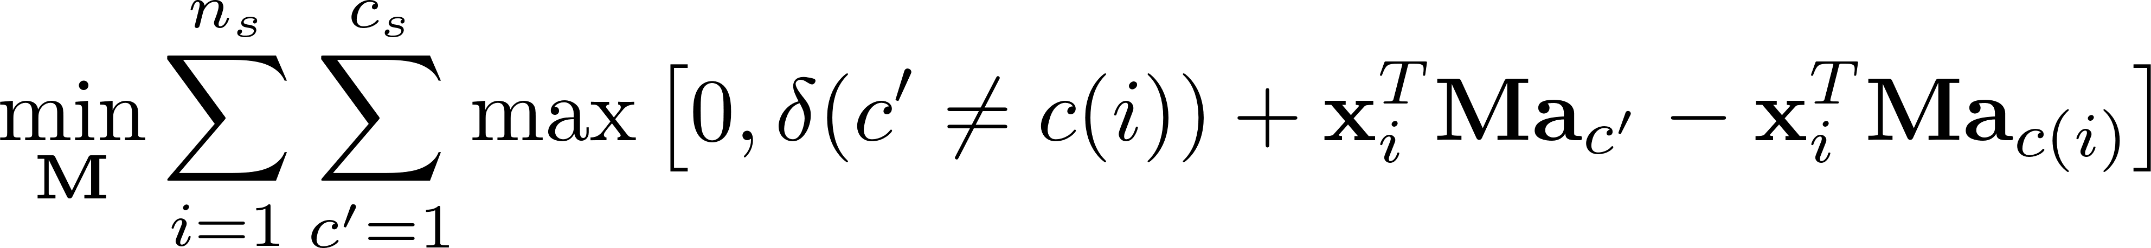
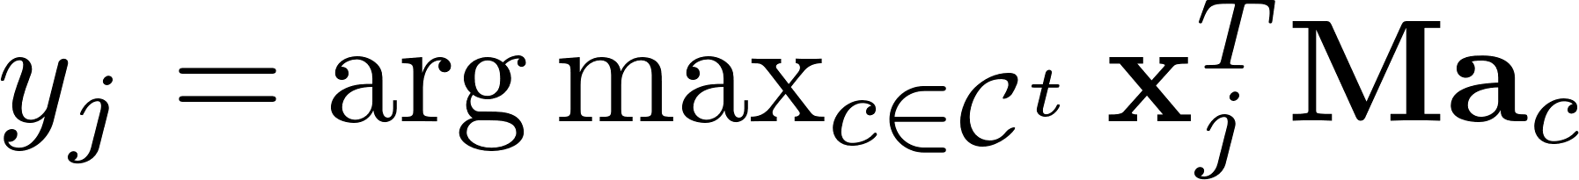
Semantic embedding methods
semantic space
visual space
zebra
[1 1 0 0 ]
tiger
[0 1 0 1 ]
whale
[0 1 1 1 ]
compatibility score
Training:
Testing:

Slide 24
Zero-shot learning methods
Semantic relatedness methods
Semantic embedding methods
Synthetic methods

Slide 25

Synthetic methods
Synthesize training samples for unseen categories and convert to traditional classification.
category space
zebra
tiger
whale
semantic space
visual space
zebra
[1 1 0 0 ]
tiger
[0 1 0 1 ]
whale
[0 1 1 1 ]

Slide 26
Synthetic methods
Synthesize training samples for unseen categories.
We only have semantic information for unseen categories.
semantic space
visual space
zebra
[1 1 0 0 ]
tiger
[0 1 0 1 ]
whale
[0 1 1 1 ]

Slide 27
Synthetic methods
Synthesize training samples for unseen categories.
We only have semantic information for unseen categories.
image
semantic
information
zebra
[1 1 0 0 ]
Generator
or
visual feature

Slide 28
Synthetic methods
Synthesize training samples for unseen categories.
We only have semantic information for unseen categories.
image
semantic
information
zebra
[1 1 0 0 ]
Generator
or
visual feature
much easier

Slide 29

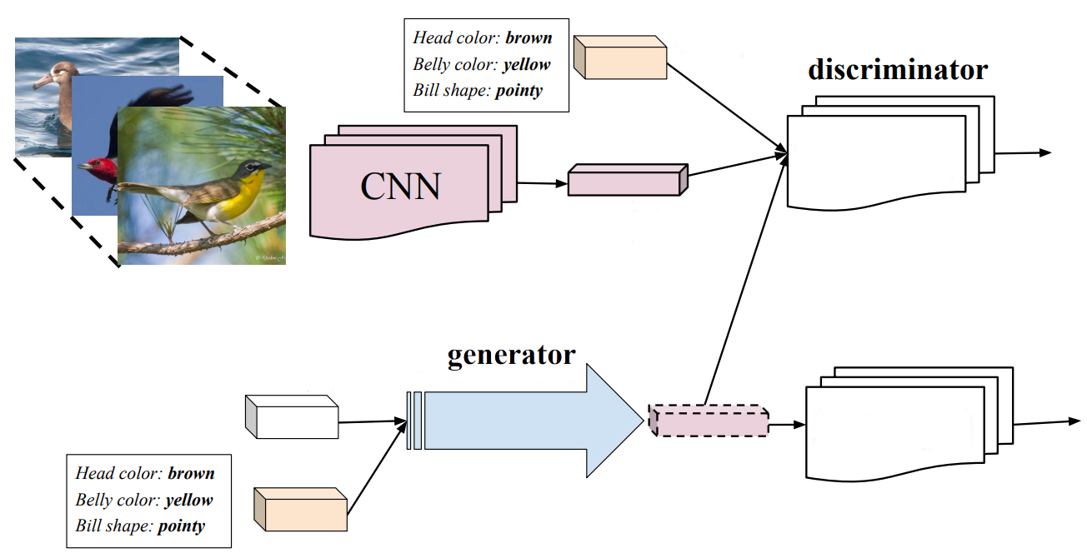
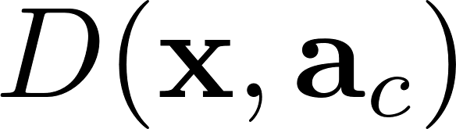

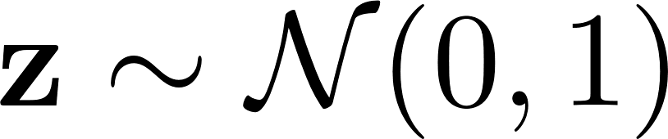
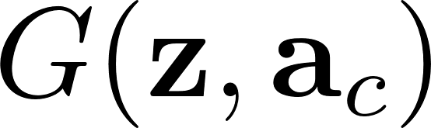
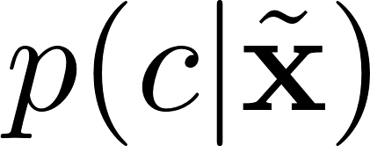


Synthetic methods
Generate visual features from semantic information.
classifier
generated features

Slide 30
Problems in zero-shot learning
projection domain shift
visual-semantic projection
black-white
has tail
lives on land
small
has tail
same “has tail” attribute
different visual appearances
gray
has tail
lives in water
big
has tail
Solution: use unlabeled test samples to adapt visual-semantic projection to unseen categories.

Slide 31
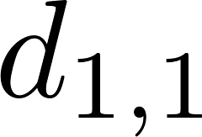
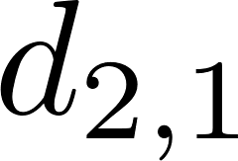
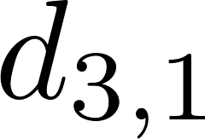
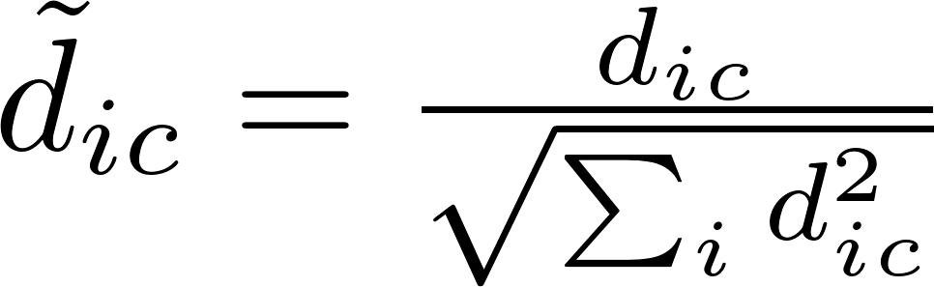
Problems in zero-shot learning
hubness problem
There are a small set of “hub” unseen categories that become the nearest neighbors to the majority of testing samples.
semantic space
visual space
zebra
[1 1 0 0 ]
hub
tiger
[0 1 0 1 ]
whale
[0 1 1 1 ]
Solution: normalize the distance

Slide 32
Problems in zero-shot learning
hubness problem
There are a small set of “hub” unseen category that become the nearest neighbors to the majority of testing samples.
semantic space
visual space
zebra
[1 1 0 0 ]
hub
tiger
[0 1 0 1 ]
whale
[0 1 1 1 ]
Solution: use ranking

Slide 33
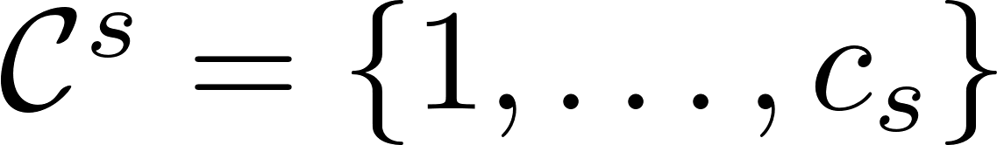
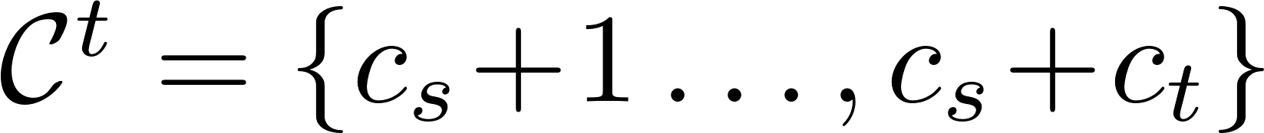
Generalized zero-shot learning
standard zero-shot learning
generalized zero-shot learning
training
categories
testing
categories
testing
categories
training
categories

Slide 34
Generalized zero-shot learning
generalized zero-shot learning
Problem: the prediction of test samples
is biased towards seen categories.
prediction score matrix
seen categories
unseen categories
test samples
higher
lower
training
categories
testing
categories
Solution
Deduct the prediction scores on seen categories by a constant
Hierarchical prediction: first predict whether seen categories or unseen categories, then predict specific category.

Slide 35
From zero shot learning to zero-shot domain adaptation
If unlabeled target domain samples are available in the training stage, use unsupervised domain adaptation.
If unlabeled target domain samples are not available in the training stage, zero-shot domain adaptation may help here.

Slide 36
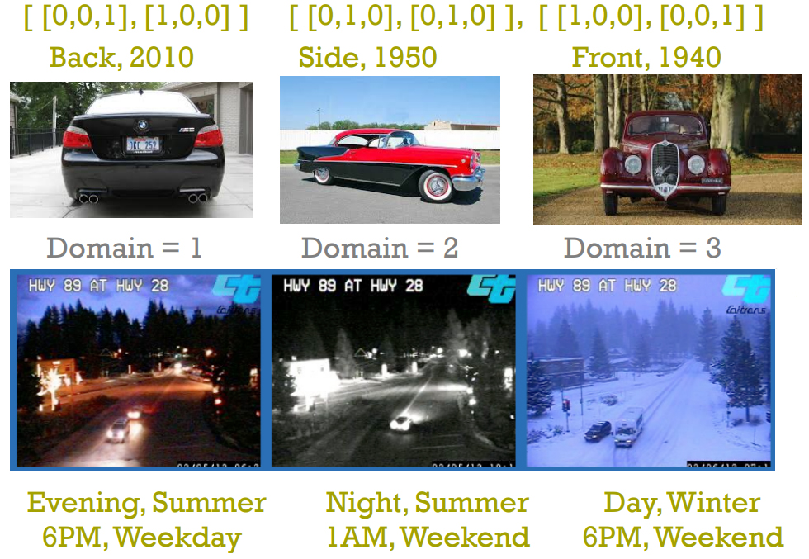
From zero shot learning to zero-shot domain adaptation
Zero-Shot learning: category attribute vector
Zero-Shot domain adaptation: domain attribute vector
domain attribute vector
car make
recognition
surveillance vehicle
detection

Slide 37
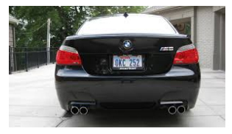
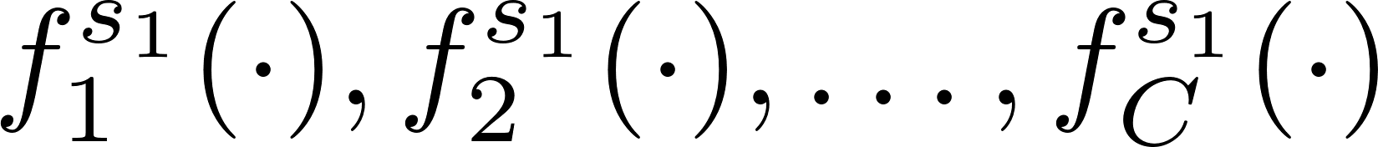
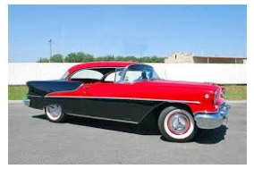
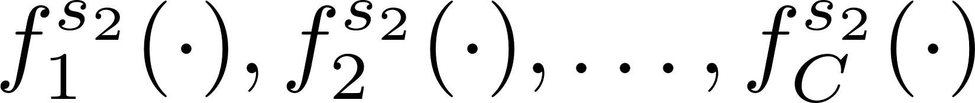

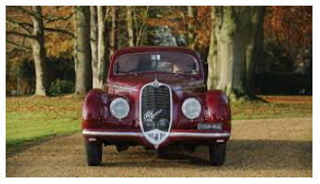

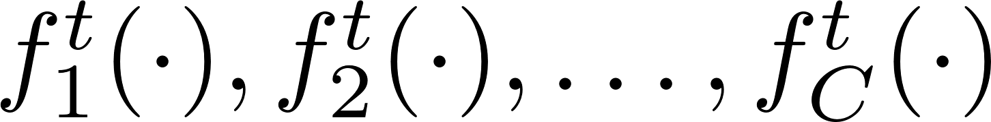
From zero shot learning to zero-shot domain adaptation
source domains
[0,0,1,1,0,0]
[0,1,0,0,1,0]
target domain
[1,0,0,0,0,1]

Slide 38
Thanks!

